Slide 1

Ramrao Adik Institute of Technology
Department of Computer Engineering
M.Tech MINI Project Presentation
On
“Buffer Overflow attack”
By
Abhinavkumar Yadav
24CO1011
Guided by
Dr. Puja Padiya

Slide 2
Buffer Overflow attack
A buffer overflow occurs when data exceeds a buffer’s allocated memory space and spills over into adjacent memory, leading to potential program errors or security vulnerabilities.
MTech Mini Project-IV Mock 2 Presentation

Slide 3
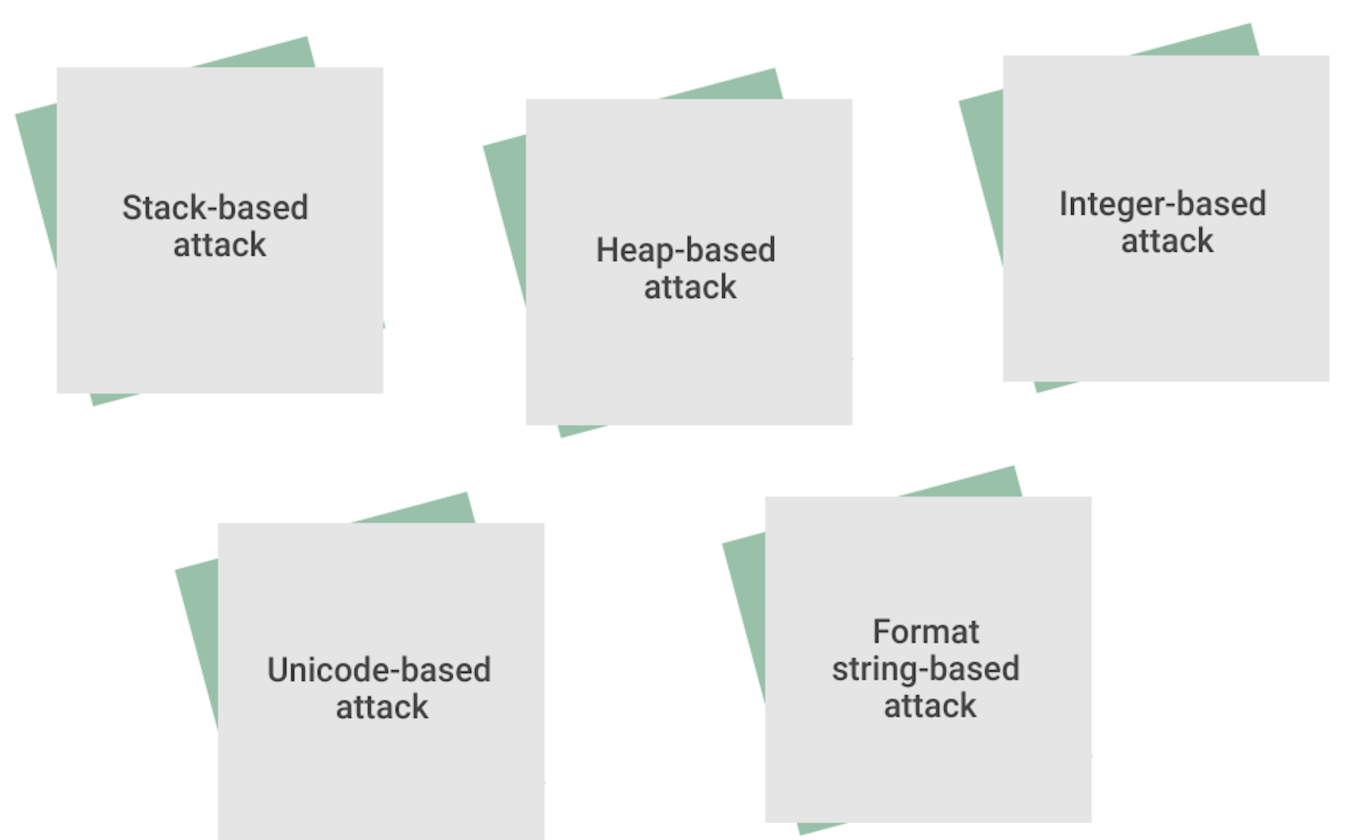
Types of Buffer Overflow
MTech Mini Project-IV Mock 2 Presentation

Slide 4
Stages of Buffer Overflow Attack
Vulnerability Identification: Locate a program with weak input validation and insufficient memory bounds checking.
Payload Crafting: Design malicious input specifically engineered to overflow buffer limits and overwrite memory.
Memory Overwrite: Inject input larger than allocated buffer, corrupting adjacent memory locations.
Payload Execution: Run the injected code to gain unauthorised system access or execute privileged commands.
MTech Mini Project-IV Mock 2 Presentation

Slide 5
Stage 1: Vulnerability Identification
Scanning for programs with poor memory management
Targeting applications written in languages like C/C++ that allow direct memory manipulation
Typical Weak Points
No Input length Validations
Improper memory management
Fixed Size Static Buffer
Direct memory pointer manipulations
MTech Mini Project-IV Mock 2 Presentation

Slide 6
Stage 2: Payload Crafting
Developing platform-specific shellcode
Generating executable Assembly code
Creating compact instruction sets
Designing multi-stage payload mechanisms
MTech Mini Project-IV Mock 2 Presentation

Slide 7
Stage 3: Memory Overwrite & Payload Execution
Injecting input larger than allocated buffer space
Manipulating memory boundaries
Controlling execution flow
Executing unauthorized system commands
MTech Mini Project-IV Mock 2 Presentation

Slide 8
Tools
Fortify
SonarQube
Metasploit Framework
Shellcode Generation
MTech Mini Project-IV Mock 2 Presentation

Slide 9
Performing the Cyber Attack
MTech Mini Project-IV Mock 2 Presentation

Slide 10
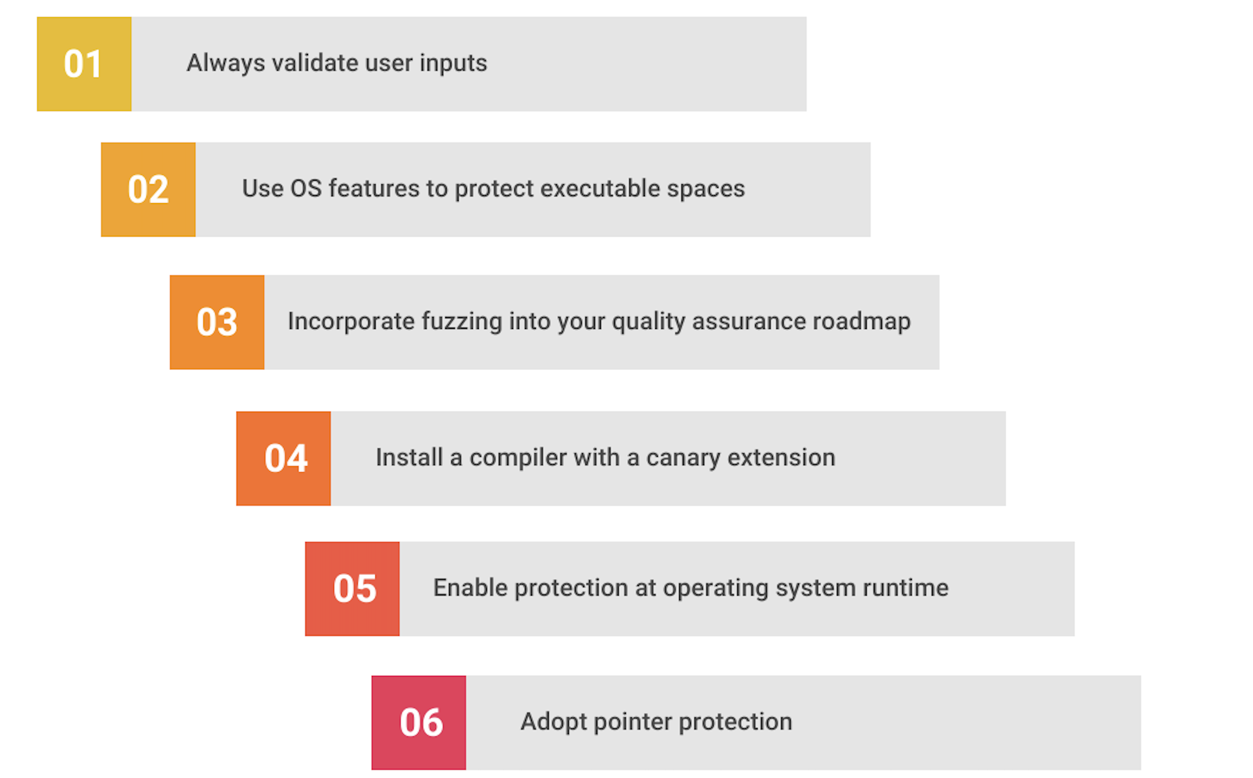
Prevention & Mitigation
MTech Mini Project-IV Mock 2 Presentation

Slide 11
Thank You

